Slide 1

GUIDED CAPSTONE PROJECT REPORT
Nathan Wodarz

Slide 2
Problem Identification
Big Mountain has added a new chair lift.
Annual operating costs will increase by $1.54 million.
Can we increase revenue or reduce costs?
We investigated ticket pricing models to determine if prices can be increased.
We evaluated four possible scenarios involving cutting costs or adding resort features for effects on revenue.

Slide 3
Recommendation and Key Findings
We recommend an increase to the daily ticket price.
The model supports an increase from $81 to $95.87.
A conservative alternative would increase to $85.48.
An increase of $0.88 will offset operating costs from the new lift.
We recommend further investigation into Scenarios 1 and 2.
In Scenario 1, we suggest further examination of closing 1, 4, 7, 8, 9, or 10 runs.
Scenario 3 is no better than Scenario 2.
Scenario 4 is no better than making no further change.

Slide 4
Recommendation and Key Findings
We identified 8 important metrics.
Vertical drop
Snow-making coverage area
Total chairs
Number of fast quads
Number of runs
Length of the longest run
Number of trams
Skiable terrain area.
We are above average in all but the number of trams.
This impact is minimized as most other resorts also lack trams.

Slide 5
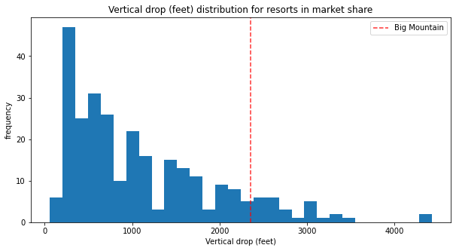
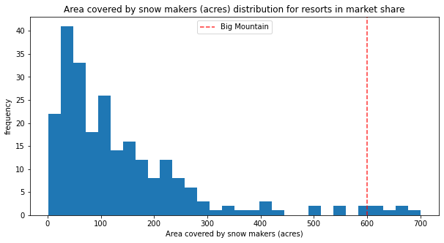
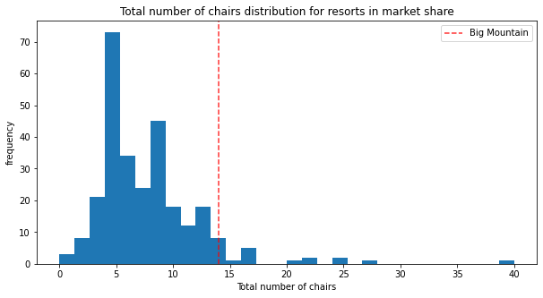
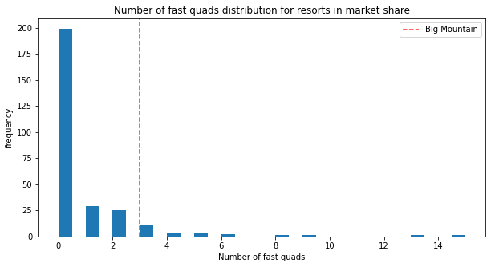
Modeling Results and Analysis
Big Mountain compares favorably in most metrics.

Slide 6
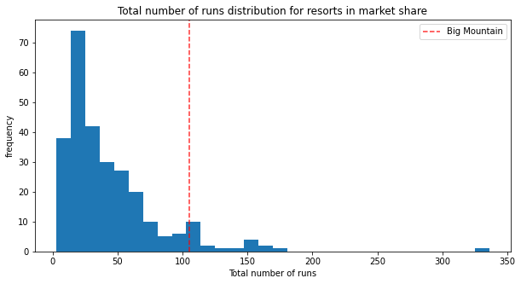
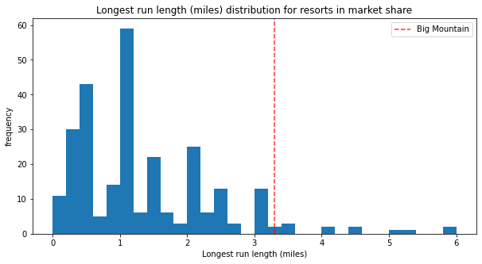
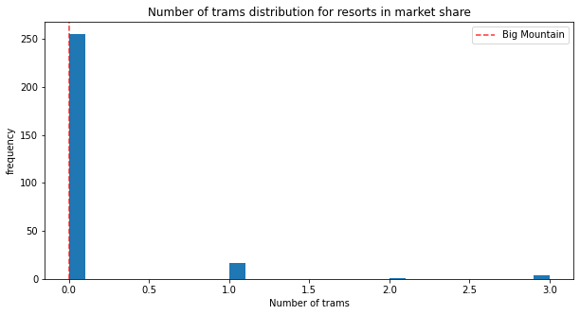
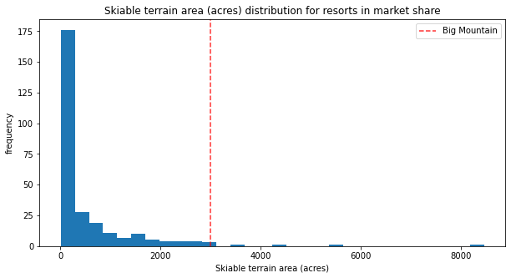
Modeling Results and Analysis
Big Mountain compares favorably in most metrics.

Slide 7
Modeling Results and Analysis
Our model suggests we are undervaluing our assets.
The model suggests we can increase the price to $95.87.
The model has a mean uncertainty of $10.39.
Even conservative increases should more than offset our operating cost increase.

Slide 8
Modeling Results and Analysis
Scenario 1: Permanently close up to 10 of the least used runs.
Model finds closing 1 run won’t affect ticket prices.
Closing 2-4 or 5-7 give same suggested ticket prices.
We are better off closing 4 than 2 or 3.
We are better off closing 7 over 5 or 6.
Scenario 2: Add run to a point 150 feet lower and install additional chair lift.
Model suggests an additional $1.99 ticket increase.
Scenario 3: Scenario 2 with additional snow making coverage.
Model again suggests $1.99 ticket increase.
Increased capital and operating costs make this worse than Scenario 2.
Scenario 4: Lengthen longest run with snow making coverage.
Model suggests to change to ticket price.
Increased costs make this worse than no change.

Slide 9
Summary and Conclusion
We recommend a ticket price increase.
We recommend further investigation of Scenarios 1 and 2.
This will require additional modeling work.
It will be necessary to compare our ticket price model to anticipated capital and operating expenditures in these scenarios.
Our model didn’t account for the number of annual guests.

